Slide 1
UNICEF/Lopez
Notes:
Child monks at Dechen Phodrang Monastic School learning prayers. The monastery sits on top of a steep hill overlooking the Bhutanese capital, Thimphu.
"Many of the children come here because their situation at home is desperate. We try to do the best we can for them," says Kencho Tshering, principal of Dechen Phodrang's monastic school. "Most don't see their families for many months, or even years, as many families can't afford the journey. There is an understanding that once the boys enter the monastery, their lives are now committed to spiritual knowledge.“
"The idea that these children have basic rights – to be protected from harm, to good health, sanitation – is a new concept to many of the monks who have themselves gone through a monastic education, where there is an emphasis on hard discipline and on total integration into spiritual life," says Dorji Wangdi, child protection officer at Unicef Bhutan.

Slide 2
Teacher slide
Contents
Slide 3 Guess the article
Slide 4 Introducing the article
Slide 5 Start thinking about Article 14
Slide 6 Making Article 14 happen
Slide 7 & 8 Primary activities
Slide 9 Reflection
Instructions
This flexible resource is intended to provide you with some easy to use, appropriate rights-related learning to share with your children, their families and your colleagues. #

Slide 3
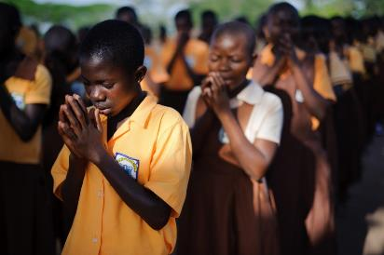
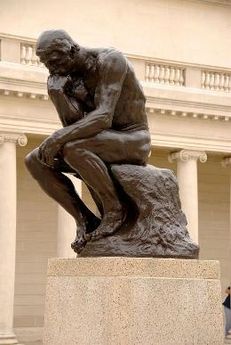
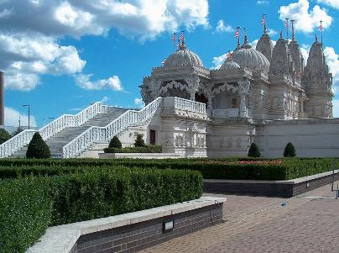
Guess the article
These pictures provide a clue to this week’s article.
How do these pictures help you? Can you guess how they are linked together?
Write down your thoughts or discuss with someone in your house.
UNICEF/Quarmyne
Wikimedia commons
Wikimedia commons

Slide 4
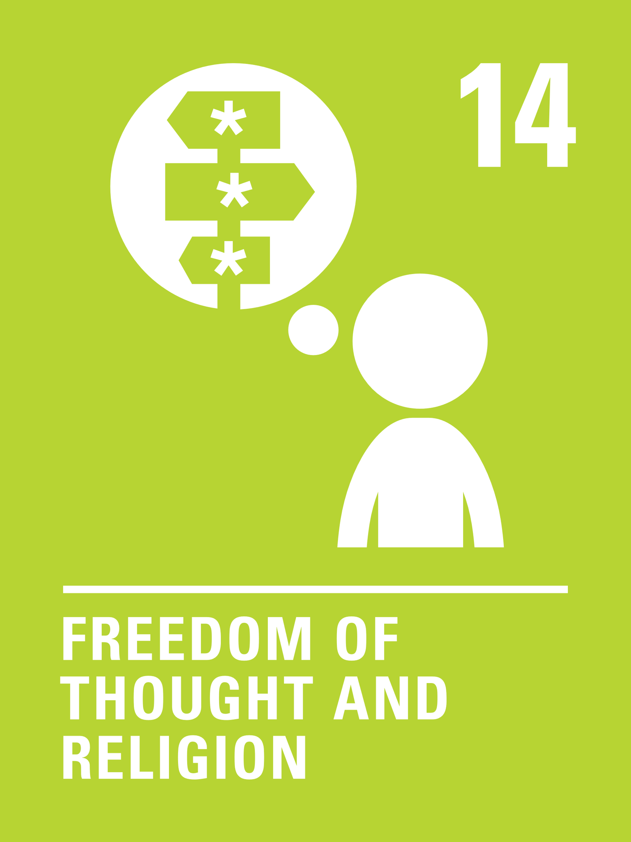
Introducing… Article 14
Samiha introduces Article 14
Article 14 – Freedom of thought, belief and religion.
Every child has the right to think and believe what they choose and also to practise their religion, as long as they are not stopping other people from enjoying their rights. Governments must respect the rights and responsibilities of parents to guide their child as they grow up.
Watch on YouTube

Slide 5
What needs to happen for you to have your thoughts and beliefs respected?
How does your school show they respect everyone’s beliefs?
Write them down and then compare your answers with the next slide.

Slide 6
How many of these did you get?
You have opportunities to have your views listened to and valued
Your food choices are respected
People have the time and space to pray or reflect
There is an opportunity to celebrate special times or festivals
You have a variety of uniform options to reflect beliefs
Everyone is encouraged to respect each other’s viewpoints
It is an inclusive environment where everyone feels welcome
Can you think of any others?

Slide 7
Activity Time
Food choices are really important to some people. Find out about the food rules of veganism or a specific religion.
All these activities are related to…
Thoughts and beliefs are usually really important to people. Write down some things you believe in strongly. Share these with your family or discuss them with your friends.
Why do you think religious buildings are important? Think of and draw a building that is important to you or make a sculpture of one of these buildings using things you can find around the house (old cereal boxes, empty toilet roll etc.). This could be a religious building like a church or a temple, or even a school or a library. Write a sentence or two about why this building is important to you.
List as many religions as you can think of. Do you know what symbols are linked with these religions? Have a go at drawing them if you can.
You don’t need to do every single activity
but if you have time you can do more than one.
Primary

Slide 8
Activity Time
Imagine you are part of your school council. What ideas do you have to make sure your school listens to the thoughts and respects the beliefs of all children?
Can you think of some items or religious artefacts that are important in our religion? For example, candles and prayer beads. Choose one and draw a scene of a child using this item.
April was an important month this year for many religions. Can you think of some festivals and events that took place in April? Work with your friends and family safely online and see how many you can think of. You could write a sentence, draw a picture or write a story about a child celebrating this festival or special day.
Primary

Slide 9
Reflection
Have a think about other rights that have links with Article 14. You might want to begin with Articles 13 and 17.
You can find a summary of the whole Convention here
UNICEF/Dawe

Slide 10
Thank you

