Slide 2
Let’s Take a Trip to the Seaside…
The place where land meets the sea is called a coast, coastline, shore, strand or seaside.
Have you ever visited the seaside?

Slide 3
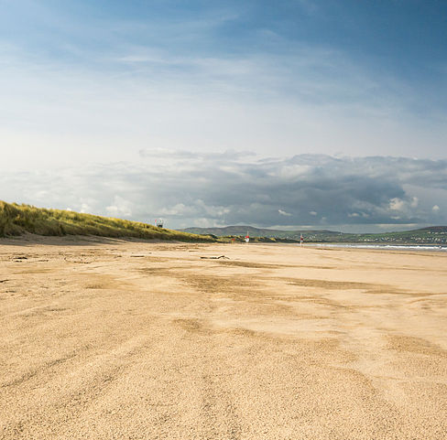
Beaches
There are lots of beaches in Northern Ireland.
Many people like to visit the beach to walk, go swimming, or even surf!
Some well-known beaches are Benone Strand, Downhill Strand, Whiterocks and Cranfield.
‘Benone Strand, Northern Ireland’ by Luke Carré ^{is licensed under CC BY 2.0}

Slide 4
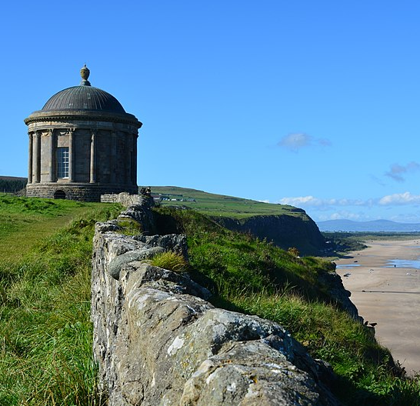
Cliffs
There are cliffs along the coastline of Northern Ireland.
The famous Mussenden Temple sits at the edge of a cliff on Downhill Strand. It is one of the most photographed buildings in Ireland.
Fairhead, near Ballycastle, is a tall cliff face. Some people go rock-climbing there.
‘Mussenden Temple Downhill Castlerock Co. Londonderry’ by D NL is licensed under CC BY 2.0

Slide 5
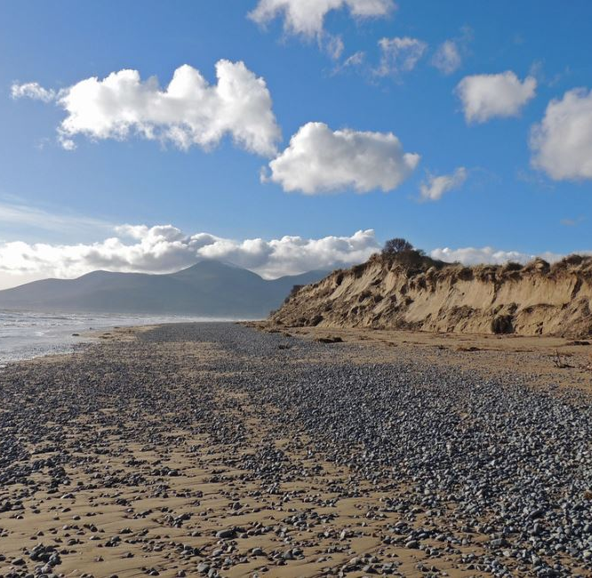
Sand Dunes
Sand dunes are hills of sand caused by strong and stormy winds blowing the sand into an area until it builds up to form dunes.
Dunes are important because different types of insects, birds and plants live in them.
In Northern Ireland, there are important sand dunes at Murlough Nature Reserve, Benone Strand, Portstewart and Tyrella Beach.
^{‘Dune erosion at Murlough NNR’} by Philip McErlean is licensed under CC BY 2.0

Slide 6
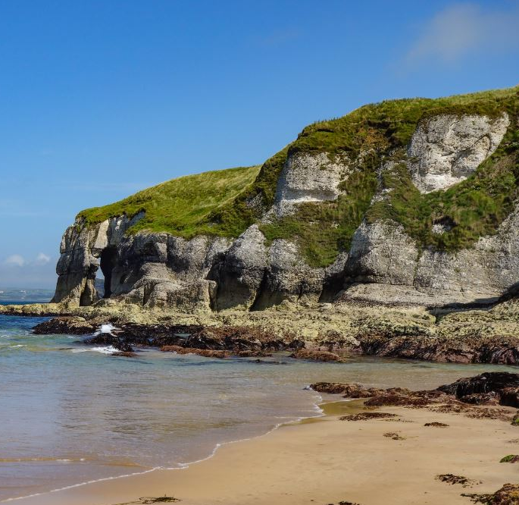
Seaside Resorts - Portrush
Portrush is in County Antrim.
Visitors and locals can enjoy three beaches, Portrush West Strand, Portrush East Strand (or Curran Strand) and Whiterocks.
There are caves and arches around Portrush with names such as, the Wishing Arch, Elephant Rock and Lion's Paw.
Portrush also has an amusement park.
‘White Rocks’ by Philip McErlean is licensed under CC BY 2.0

Slide 7
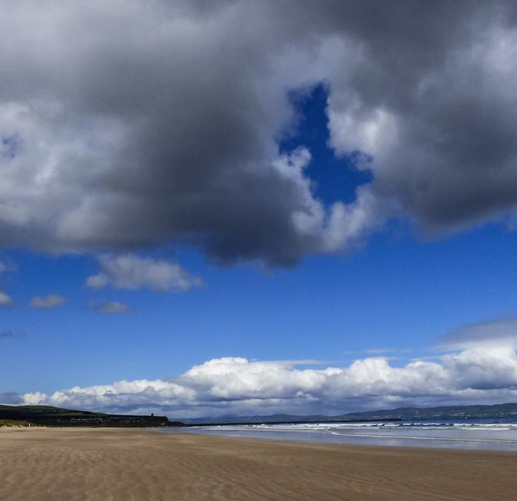
Seaside Resorts - Portstewart
The seaside town of Portstewart has a lovely beach and harbour.
Surfing, walking, horse-riding, picnicking and bird watching are all popular activities.
A coastal cliff walk called the Port Path links Portstewart and Portrush.
‘Portstewart strand’ by Michael Clarke is licensed under CC BY 2.0

Slide 8
Seaside Resorts - Newcastle
Newcastle is a seaside resort beside the Irish Sea.
It is in County Down.
The Mourne Mountains rise above the town.
The town’s beach and promenade are very popular with walkers.
‘Dundrum Panorama’ by David in Lisburn is licensed under CC BY 2.0

Slide 9
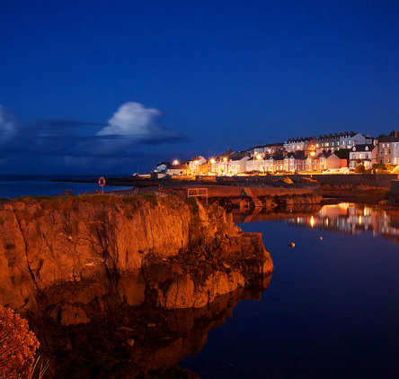
Seaside Resorts - Bangor
Bangor is a popular seaside destination in County Down.
The largest marina in Northern Ireland is in Bangor.
A marina is a place to anchor boats.
Lots of people also visit the family fun park in the town.
‘The Long Hole in Bangor, Northern Ireland’ by Geograph is licensed under CC BY 2.0

Slide 10
Additional Activities
Are there any beaches or seaside towns near you? Find out what they are called.
Talk to your partner about your favourite things to do at the seaside.

