Slide 1
Unicef/@katchyphotos
Notes:
“It is not okay how society is targeting Asian people recently because of the coronavirus. Just because the virus was first found in China doesn't mean that Asians were the reason why the virus is spreading. It is not our fault. we are all humans with feelings and emotions and we're all feeling scared too but that doesn't excuse discrimination and racial slurs towards us Asians. This is affecting our community such as a local Asian businesses are closing down because no one is willing to go there and there is a spread of Asian harassment believe it or not. So this is a reminder that we are all on the same page and that we are not the enemy. we should work together to fight the virus not the people.”
Sophia (pictured) lives in the US, and is an avid social media user. She was ecstatic to hear that she would have no school or homework for over a month because of the coronavirus crisis; however, it wasn’t until about two days in when she started to feel the effects of not being able to see her friends. Lots of teens were searching for a way to express themselves through their photographs and be creative during this unique time. All shared a thirst for new inspiration and the tenacity to continue documenting their lives with our photographs.
Using Instagram's messaging system, a small group of teen photographers was formed and created Covid-19 Photos For Teens on 16 March 2020. They are a group of 15 boys and girls from places such as Denmark, India, Canada, and the US. Covid-19 Photos For Teens is becoming known for their positive outlook on current situations. Their Instagram posts encourage kids to support, create, and inspire one another.
Unicef/@katchyaphotos

Slide 2
Teacher slide
Contents
Slide 3 Exploring Article 2
Slide 4 How many of these did you get? – the answers
Slide 5 & 6 Primary Activities
Slide 7 Reflection
Instructions
This flexible resource is intended to provide you with some easy to use, appropriate rights-related learning to share with your children, their families and your colleagues.

Slide 3
Exploring Article 2
What is needed for every child to be able to enjoy all their rights fairly and equally?
Note down your thoughts and compare with the next slide.

Slide 4
How many of these did you get?
Every young person and child should know that their race, gender, ability, nationality (or other characteristic or identities) should not stop them enjoying all their rights.
Nobody should feel that they are treated differently because of who they are.
All people should accept, respect and value others for who they are.
All schools should teach and practise and actively celebrate respect for all.
Learning should include opportunities to empathise with those who are discriminated against.
Government decisions and the law should show the way against all forms of discrimination.
Everyone should be open to the fact that we all have prejudices and be ready to challenge them.
People challenge and speak up about any discrimination they experience or see.
Newspapers and other information sources should promote and celebrate diversity and inclusion.

Slide 5
Activity Time
Imagine that you are treated differently and not allowed to go to school, have friends and play because of the colour of your hair. … How would this feel? What would you say and do? Discuss this with the grown ups at home.
Being happy and proud about who we are as people is important. Have you read ‘The Flamingo Who Didn’t Want To Be Pink’? Watch the story made by children at William Tyndale School. Try to get all your family and friends to tell you the best things they like about being themselves and the best things about you.
All these activities are related to…
Article 2 uses some words you might not know very well. Look up discrimination, ethnicity, race and gender to find out what they mean. Try to explain Article 2 to somebody at home now that you know the meaning of these words.
Think of somewhere that you know well. It might be a library, a park or a swimming pool. Does it welcome everyone? Can all children take part there equally? Talk to your friends or family about what could make this place better for everyone.
You don’t need to do every single activity
but if you have time you can do more than one.
Primary

Slide 6
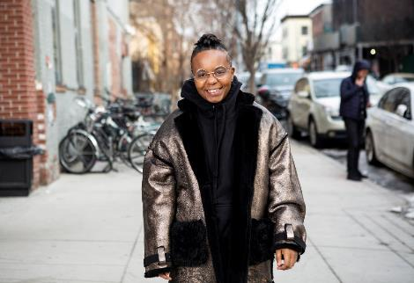
Reflection
Try to find somewhere peaceful and spend a few minutes being quiet and still … then think about these questions…
What makes you different from everyone else? What makes you proud to be you?
What could you do or say to other people to help them feel positive about who they are as people?
When you see or hear racism and other forms of discrimination what do you do to challenge what you are witnessing?
Write down your thoughts and if you want share this back with your teacher, friends or family.
Image: Beyond the Binary

Slide 7
Thank you

