Slide 1
Unicef/Mawa
Notes:
Mosharef , a teacher dancing with students at Ambag Primary School Gazipur, Bangladesh. March 2019.
Unicef/Mawa

Slide 2
Teacher slide
Contents
Slide 3 Guess the article - images as clues to identify the article
Slide 4 Introducing the article
Slide 5 Exploring Article 30
Slide 6 Exploring Article 30 – answers
Slide 7 & 8 Primary activities
Slide 9 Reflection
Instructions
This flexible resource is intended to provide you with some easy to use, appropriate rights-related learning to share with your children, their families and your colleagues.

Slide 3
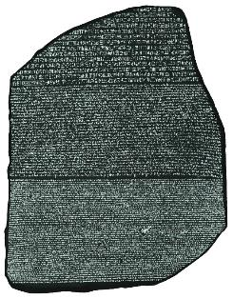
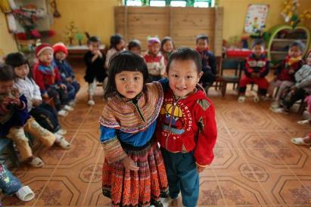
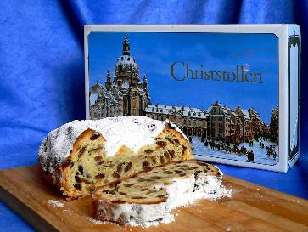
Guess the article
These pictures provide a clue to this week’s article.
Can you guess how they are linked together? Which article of the Convention do these pictures relate to?
Write down your thoughts or discuss with someone in your home.
WikiCommons
Unicef/Estey
WikiCommons
Notes:
From left to right:
1. Mumbai, India, December 2018: Members of the transgender community in India and allies protesting against the regressive provisions of the Transgender (Protection of Rights) Bill. Wikicommons
2. Recently married couples leaving the City Hall in Seattle are greeted by well-wishers on the first day of same-sex marriage in Washington state after enactment of Washington Referendum 74 Dennis Bratland/Wikicommons
3. Baltimore, US, July 2016: An image from a Black Lives Matter march through downtown Baltimore City. John Lucia/Wikicommons – licence: https://creativecommons.org/licenses/by/2.0/deed.en

Slide 4
Introducing… Article 30
Gerry introduces Article 30
Article 30 - Minority or indigenous groups, culture, language and religion
Every child has the right to learn and use the language, customs and religion of their family whether or not these are shared by the majority of the people in the country where they live.
Watch Gerry on YouTube

Slide 5
Exploring Article 30
What can you do to help all children enjoy their right to learn and to use the language, customs and religion of their family even if they are not the majority?
Note down your thoughts and compare with the next slide.

Slide 6
How many of these did you get?
Be able to speak your own language with friends and family without other people saying it’s rude.
Learn about different languages, cultures and religions.
Read books by lots of different kinds of writers from all around the world.
Learn about the world through the eyes of different people.
Celebrate lots of special events like Burn’s night, Chinese New Year, St David’s Day, Carnival.
Enjoy food, music and dance from different countries.
What else did you think of?

Slide 7
Activity Time
Do you know any traditional dances? Research these safely online or ask a friend or grown up to teach you and practise the steps.
Find 10 characters from your favourite books. Do they come from a range of cultures or are they all just like you?
All these activities are related to…
Can you find out how to say ‘”Hello, how are you?”’ in 5 different languages.
Share with friends and see how many you can get as a group.
Culture means traditions that groups follow like food, dances, song and clothes. Draw or write about what is important in your culture. Then think of someone who comes from a different culture and share safely with them what is important about culture for each of you. This could be someone you know or you could pick a country or indigenous group and write to a child of that country or group.
You don’t need to do every single activity
but if you have time you can do more than one.
Primary

Slide 8
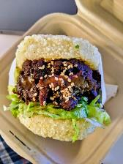
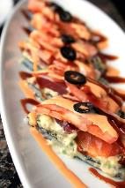
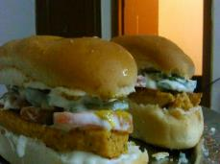
Activity Time
Watch ‘If the World were a Village of 100 People’ to find out about people around the world.
Keep a food and drink diary for the week. What cultures do your food and drink come from? Which are your favourites?
Can you guess what kinds of fusion foods these are? Fusion food combines elements from different cultures. Invent a recipe for your own fusion food.
A lot of our food originates from other cultures. Design a menu for your household for the week that involves food from different cultures. Prepare one or two of the meals for the people you live with.
What does it mean to be from a minority or indigenous group? Find out what the words mean and then think about which minority groups there are in the UK. Why do you think Article 30 is important and how does it link to last week’s work on Article 2?
Wikicommons
Primary

Slide 9
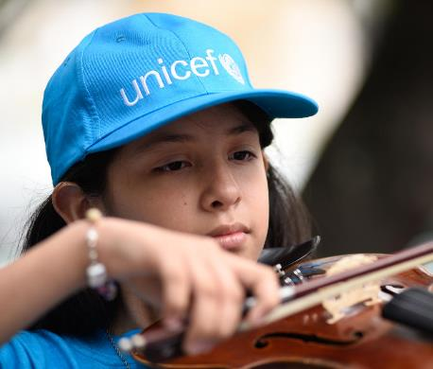
Reflection
Try to find somewhere peaceful and spend a few minutes being quiet and still … then think about these questions…
What do you do in your own life to respect your right and other children’s right to learn and use the language, customs and religion of their family?
How do you celebrate other children’s cultures?
When you hear people laughing at or being rude about other traditions, what do you do?
Write down your thoughts and if you want, share this back with your teacher, friends or family.
Uncief/Cabra

Slide 10
Thank you

